Slide 1
Electric Power Analysis

Slide 2
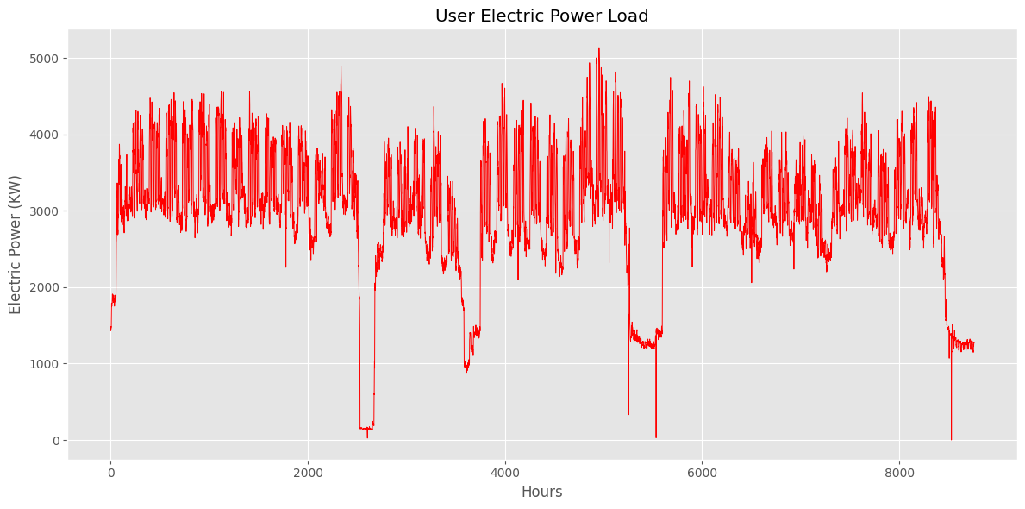
User Load Analysis

Slide 3
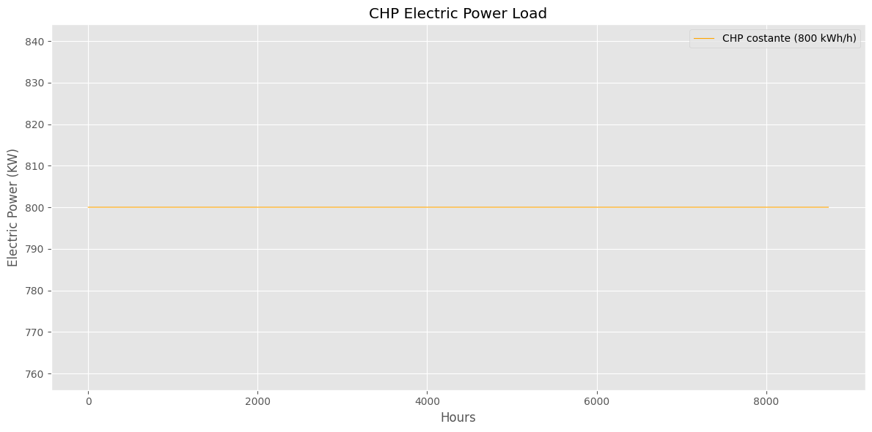
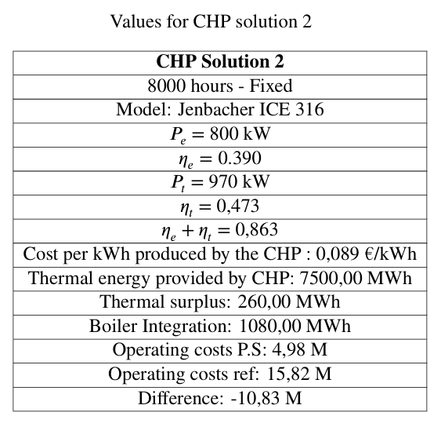
Proposed CHP System
Jenbacher ICE 316

Slide 4
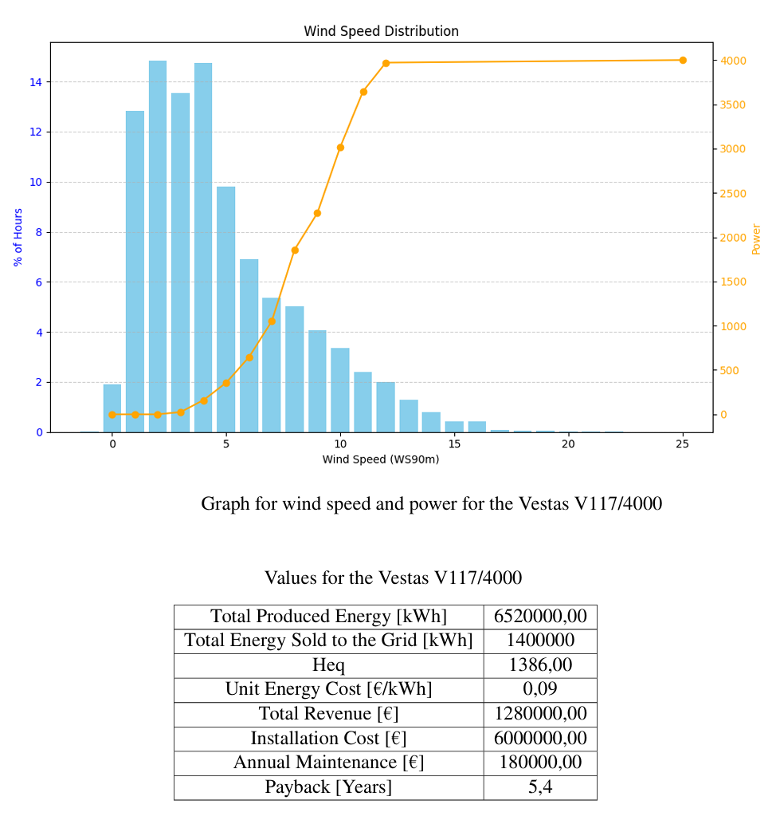
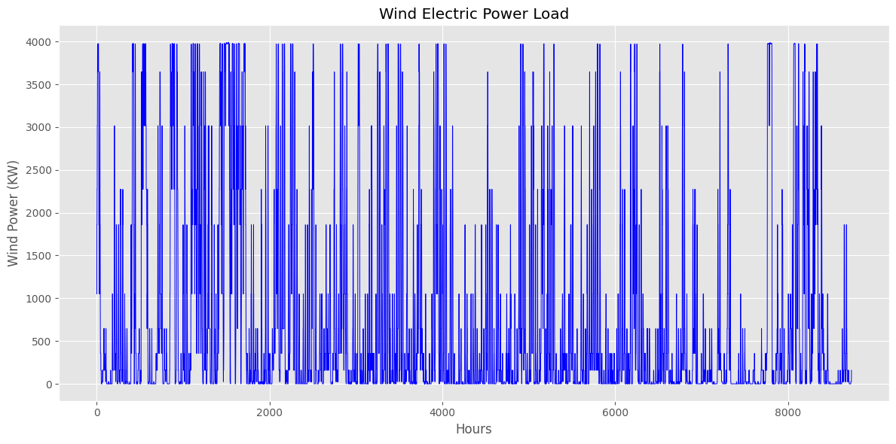
Proposed Wind System

Slide 5
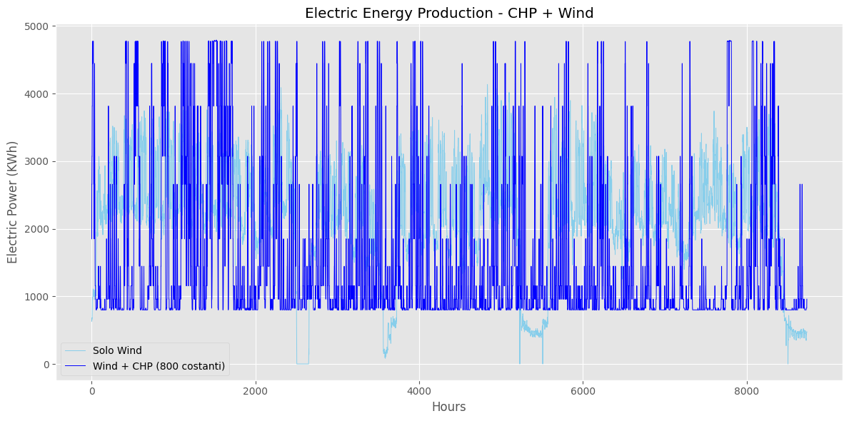
CHP + Wind
Jenbacher ICE 316 + Vestas V117/4000

Slide 6
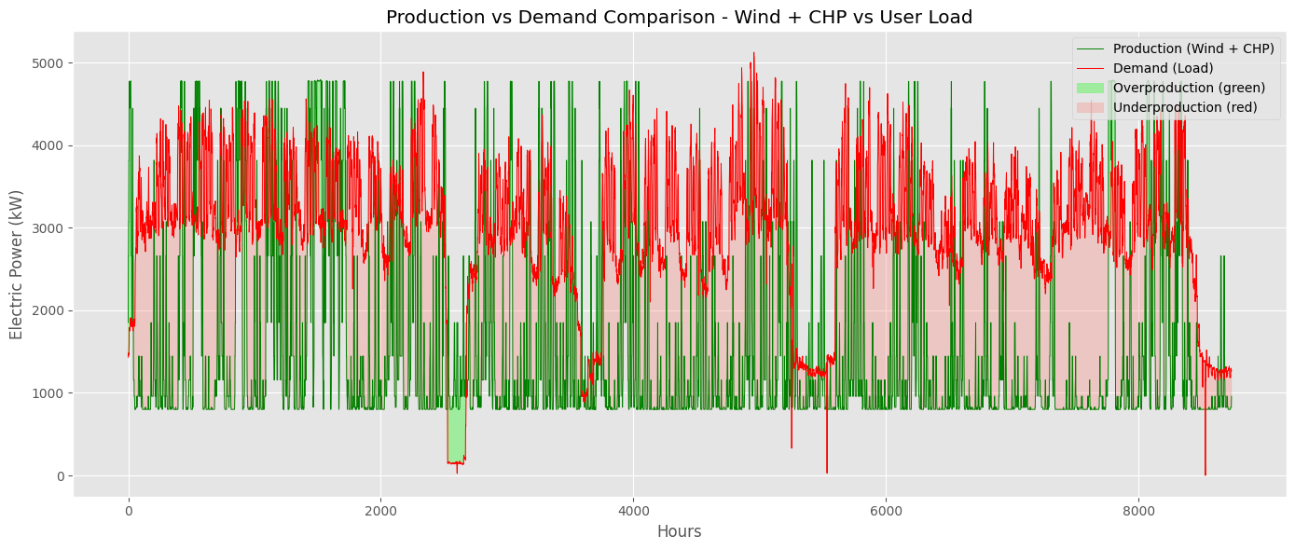
Results

Slide 7
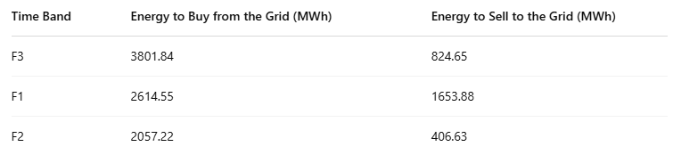
Results

